Slide 1
E-Commerce & Retail Store Analysis
Presented by Enwelum Chiamaka
Tools: Python (EDA) | Power BI (Dashboard)

Slide 2
Welcome to a Data Driven Insight
Unlocking growth and optimizing Performance In an Ecommerce Analytics

Slide 3
Company Background
Brief overview of the company:
An e-commerce company is facing multiple operational challenges that hinder growth and customer satisfaction. To address these issues, the company is leveraging data-driven insights to optimize operations.
Key business areas: financial performance, customer insights, logistics & fulfillment, product management, customer satisfaction & returns
Dataset covers 4 months of sales data

Slide 4
FINANCIAL PERFORMANCE ANALYSIS
Analyzing total revenue growth over time. Identifying best-selling products and seasonal sales trends. Calculating the average order value to understand spending behavior
CUSTOMER INSIGHTS ANALYSIS
Identifying top-performing locations based on sales volume. Analyzing order cancellation trends and customer retention. Differentiating B2B vs. B2C customer behavior for targeted marketing
LOGISTICS & FULFILLMENT OPTIMIZATION
Addressing shipping delays by calculating average shipping times. Comparing orders fulfilled by Amazon vs. Merchant fulfillment. Improving order processing for faster deliveries
PRODUCT MANAGEMENT & INVENTORY OPTIMIZATION
Identifying high-demand product categories. Analyzing the average quantity ordered for efficient stock management. Enhancing inventory control to prevent stockouts or overstocking
CUSTOMER SATISFACTION & RETURNS
Investigating high return and cancellation rates. Identifying problematic products/categories to enhance quality. Improving customer experience through better service policies

Slide 5
Problem Statement
Orders are being delayed, canceled, or returned frequently, affecting customer satisfaction and revenue. The company wants to identify operational inefficiencies and optimize product and fulfillment performance.

Slide 6
Challenges Faced
Data quality issues (missing or inconsistent order statuses)
Date hierarchies for trend analysis (month, week, weekday)
Identifying operational KPIs in a concise one-page dashboard

Slide 7
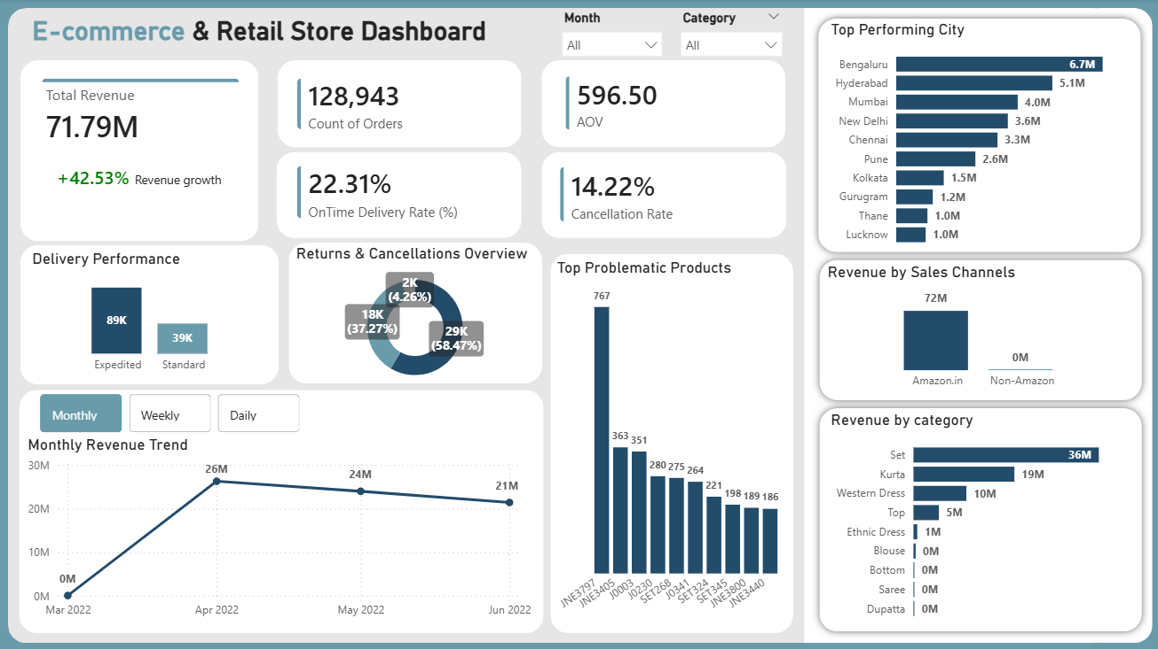

Slide 8
Key Performance Indicators
Total Revenue: ₹71.79M & Revenue Growth (MoM): 42.53%
Count of Order: 128,943
On-Time Delivery Rate: 22.31%
Average Order Value: ₹596.50
Cancellation Rate: 14.22%

Slide 9
KPI Explanation
Total Revenue + Revenue Growth (MoM): Shows how much money the company earned and the month-over-month growth trend. Helps understand overall financial performance and business scaling.
1
Count of Order: Measures the total number of orders over time. Indicates sales volume and customer demand trends.
2
On-Time Delivery Rate: Measures how many orders were delivered on time. Reflects logistics efficiency and fulfillment reliability.
3
Average Order Value: Helps understand customer spending behavior and product pricing effectiveness.
4
Cancellation Rate: Percentage of orders that were canceled. Highlights operational challenges or customer dissatisfaction.
5

Slide 10
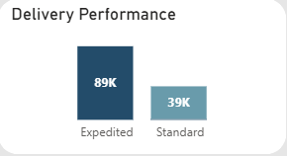
Delivery Performance
Purpose of the Chart: Shows how delivery speed and fulfillment method impact delivery performance. Helps identify which service level and fulfillment type achieve higher on-time delivery.
Key Insight: Expedited shipping fulfilled by Amazon has significantly higher delivery numbers compared to standard shipping, indicating that faster shipping methods and reliable fulfillment partners improve operational efficiency.

Slide 11
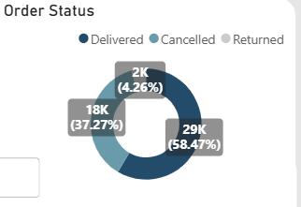
Order Status
Purpose of the Chart: Provides a quick snapshot of how orders are completing versus failing. Highlights customer satisfaction and operational efficiency.
Key Insight: Most orders (58.47%) were successfully delivered. However, a high percentage of canceled orders (37.27%) indicates operational challenges or customer dissatisfaction. Returned orders are relatively low (4.26%) but still point to product or fulfillment issues that need attention.

Slide 12
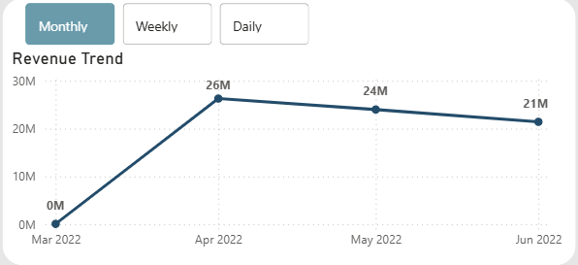
Monthly Revenue Trend
Purpose of the Chart: Shows how revenue changes across each month within the analysis period.
Key Insight: This chart shows how much money the company made each month. Revenue increased sharply in April, then reduced slightly in May and June, showing where growth happened and where improvement is needed.

Slide 13
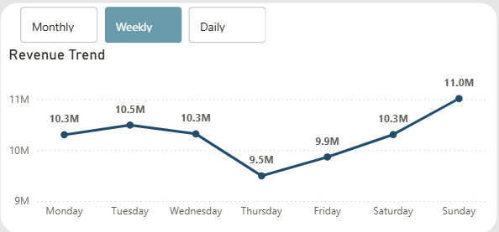
Weekly Revenue Trend
Purpose of the Chart: Analyzes customer purchasing behavior across weekdays to identify high-performing and low-performing days.
Key Insight: Revenue is highest on Sundays and early in the week. Sales drop toward Thursday and Friday, showing when customers are most and least active.

Slide 14
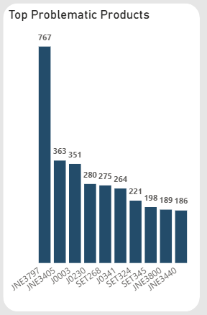
Top Problematic Products
Purpose of the Chart: Identifies product styles with the highest number of failed orders to pinpoint operational and customer satisfaction issues.
Key Insight: A small number of product styles account for a large share of failed orders, with JNE3797 standing out as the biggest operational risk. The high concentration of failed orders around specific product styles suggests potential issues related to product quality, sizing, fulfillment accuracy, or customer expectations.

Slide 15
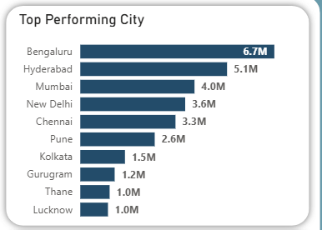
Top Performing City by Revenue
Purpose of the Chart: To identify the highest-revenue-generating cities and understand where the business is currently strongest geographically.
Key Insight: Bengaluru, Hyderabad, and Mumbai dominate revenue among the top 10 cities.

Slide 16
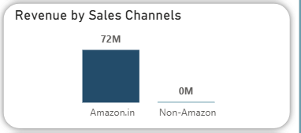
Revenue by Sales Channels
Purpose of the Chart: To evaluate how revenue is distributed across sales channels and assess the company’s dependence on each channel.
Key Insight: While Amazon.in is a strong revenue driver, the low contribution from non-Amazon channels highlights a potential risk of channel dependency and an opportunity to diversify revenue sources.

Slide 17
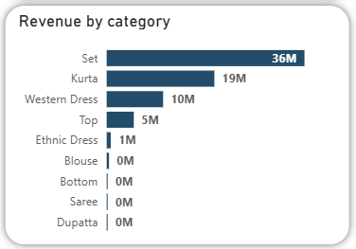
Revenue by Category
Purpose of the Chart: To identify which product categories drive the most revenue and understand customer purchase preferences.
Key Insight: Revenue is highly concentrated in a few categories, indicating that Sets, Kurtas and western dress are the company’s core revenue drivers, while several categories underperform and may require repositioning, promotion, or rationalization.

Slide 18
Conclusion
The analysis of the e-commerce and retail store data highlights several key insights:
Revenue Performance: Strong growth was observed in April, with total revenue driven primarily by Amazon.in and top categories such as Sets, Kurtas, and Western Dresses.
Customer & Operational Insights: Delivered orders constitute 58.47% of total orders, but a high cancellation rate (37.27%) indicates operational or fulfillment challenges.
Top Performing Markets: Bengaluru, Hyderabad, and Mumbai are the leading revenue-generating cities.
Problematic Products: Specific product styles, notably JNE3797, show disproportionately high failed orders, signaling product or fulfillment issues.
Channel & Category Dependence: Heavy reliance on Amazon.in and a few key categories highlights potential risk concentration.
Overall, the company exhibits strong growth potential but faces operational inefficiencies and revenue concentration risks that require strategic action.

Slide 19
Recommendation
Operational Improvements: Investigate high cancellation and return rates; enhance fulfillment accuracy and delivery reliability.
Product Focus: Review top problematic products (e.g., JNE3797) for quality, sizing, or listing improvements to reduce failures.
Channel Diversification: Strengthen non-Amazon sales channels to reduce dependency and mitigate risk.
Market Strategy: Prioritize marketing and inventory for high-performing cities (Bengaluru, Hyderabad, Mumbai) while exploring growth opportunities in underperforming cities.
Category Optimization: Focus on high-revenue categories (Sets, Kurtas, Western Dresses) while reassessing low-performing categories for promotion, repositioning, or discontinuation.
Data-Driven Monitoring: Implement continuous dashboard monitoring to track revenue trends, returns, cancellations, and top-performing products for proactive decision-making.

Slide 20
Thank You
Linkedin: https://www.linkedin.com/in/enwelum-chiamaka Github: https://github.com/amieecode Email: enwelumchiamaka@gmail.com

